Slide 1


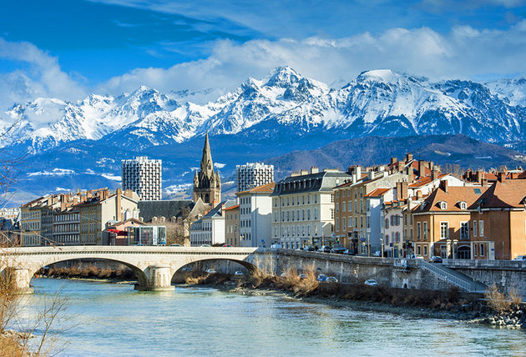
Hierarchical Bayes and free energy
Karl Friston, University College London
Abstract: How much about our interactions with – and experience of – our world can be deduced from basic principles? This talk reviews recent attempts to understand the self-organised behaviour of embodied agents, like ourselves, as satisfying basic imperatives for sustained exchanges with the environment. In brief, one simple driving force appears to explain many aspects of action and perception. This driving force is the minimisation of free energy, surprise or prediction error that – in the context of perception – corresponds to Bayes-optimal predictive coding. We will look at some of the phenomena that emerge from this principle; such as hierarchical message passing in the brain and the perceptual inference that ensues. I hope to illustrate the ensuing dynamics using illustrations of action, action observation and the active (sensing) of the visual world. I hope to conclude with an illustration of the same principles at a microscopic level, using morphogenesis as an example.
Key words: active inference ∙ autopoiesis ∙ cognitive ∙ dynamics ∙ free energy ∙ epistemic value ∙ self-organization
.

Slide 2

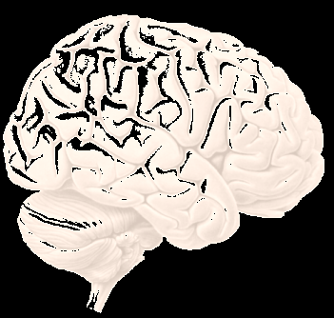
Overview
Prediction and life Markov blankets and ergodic systems
Simulations of a primordial soup
The anatomy of inference Graphical models and predictive coding
Canonical microcircuits
Action and perception
Knowing your place Multi-agent prediction
Morphogenesis

Slide 3
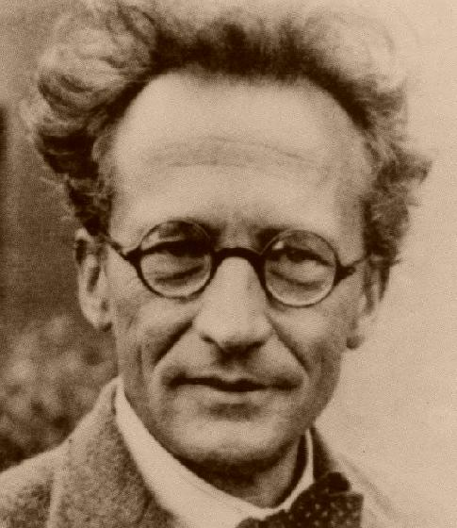
“How can the events in space and time which take place within the spatial boundary of a living organism be accounted for by physics and chemistry?”
(Erwin Schrödinger 1943)
The Markov blanket as a statistical boundary (parents, children and parents of children)
Internal states
External states
Sensory states
Active states

Slide 4
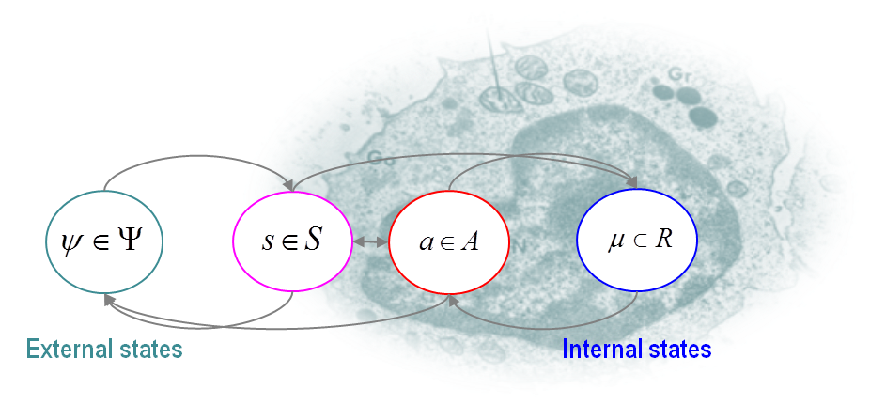
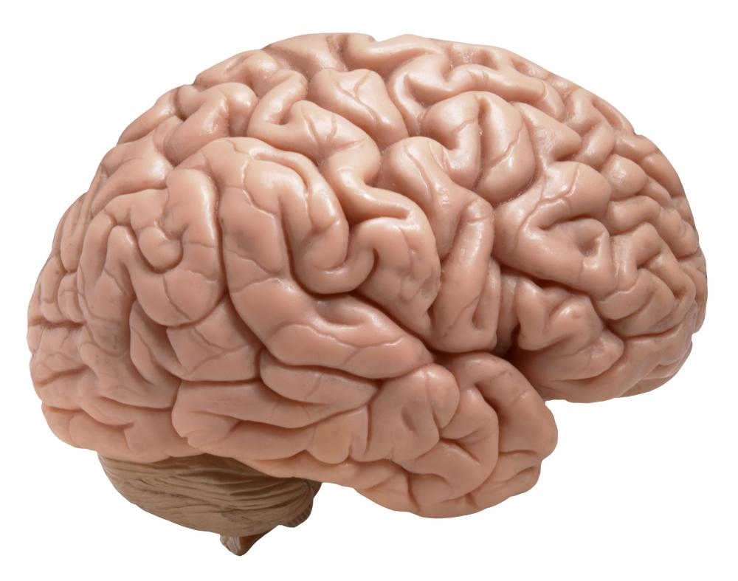
The Markov blanket in biotic systems
Sensory states
External states
Internal states
Active states

Slide 5


lemma: any (ergodic random) dynamical system (m) that possesses a Markov blanket will appear to engage in active inference
The Fokker-Planck equation
And its solution in terms of curl-free and divergence-free components
Notes:
5

Slide 6
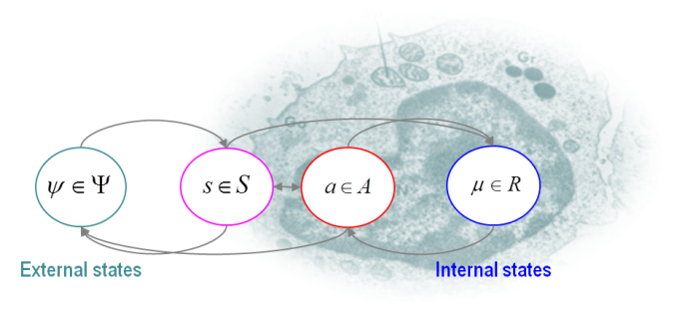
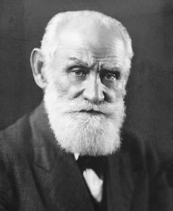
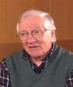
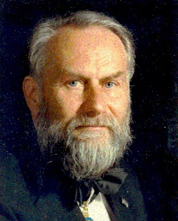
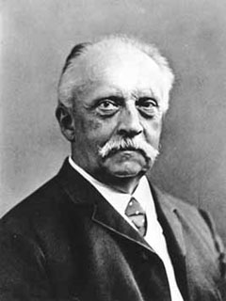
But what about the Markov blanket?
Perception
Action
Value
Surprise
Entropy
Model evidence
Reinforcement learning, optimal control
and expected utility theory
Information theory and minimum redundancy
Self-organisation, synergetics and homoeostasis
Bayesian brain, active inference and predictive coding
Pavlov
Barlow
Haken
Helmholtz

Slide 7
Overview
Prediction and life Markov blankets and ergodic systems
Simulations of a primordial soup
The anatomy of inference Graphical models and predictive coding
Canonical microcircuits – in the brain
Saccadic searches and salience
Knowing your place Multi-agent prediction
Morphogenesis – in other animals

Slide 8
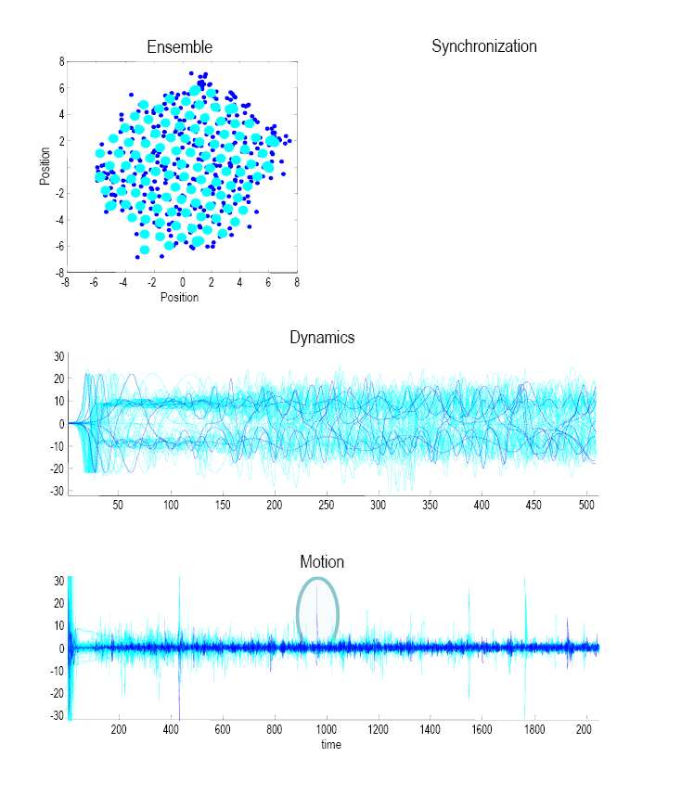
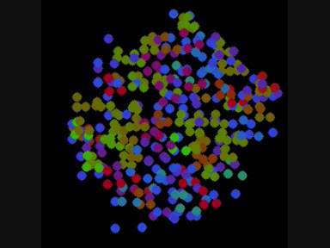
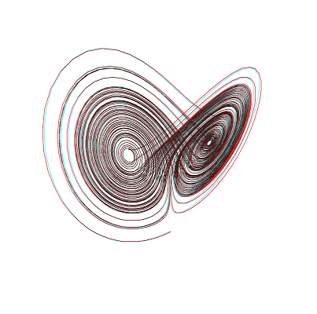
Simulations of a (prebiotic) primordial soup
Position
Short-range forces
Strong repulsion
Weak electrochemical attraction

Slide 9
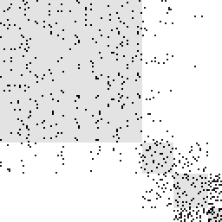
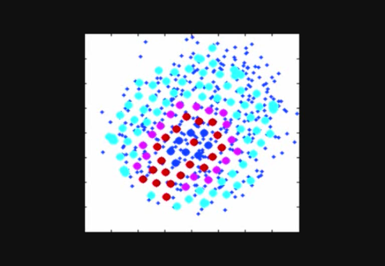
Finding the (principal) Markov blanket
Markov blanket matrix: encoding the children, parents and parents of children
Markov Blanket = [B · [eig(B) > τ]]
Adjacency matrix
Markov Blanket
20
Hidden states
40
A
60
80
Sensory states
100
Active states
Internal states
120
20
40
60
80
100
120
Element
Does action maintain the structural and functional integrity of the Markov blanket (autopoiesis) ?
Do internal states appear to infer the hidden causes of sensory states (active inference) ?

Slide 10
Autopoiesis, oscillator death and simulated brain lesions

Slide 11
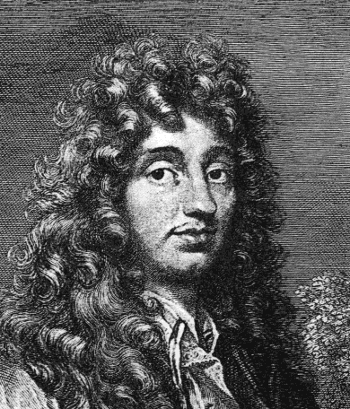
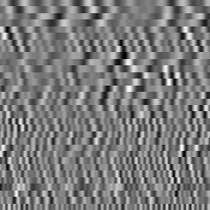
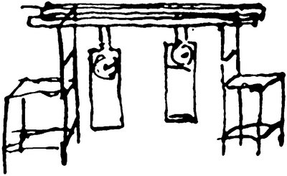
Decoding through the Markov blanket and simulated brain activation
True and predicted motion
0
Christiaan Huygens
-0.1
Motion of external state
Predictability
-0.2
8
-0.3
6
-0.4
4
2
100
200
Time
300
400
500
Position
0
-2
Internal states
-4
-6
5
-8
-5
0
5
10
Position
Modes
15
20
25
30
100
200
Time
300
400
500

Slide 12
Interim summary
The existence of a Markov blanket necessarily implies a partition of states into internal states, their Markov blanket (sensory and active states) and external or hidden states.
Because active states change – but are not changed by – external states they minimize the entropy of internal states and their Markov blanket. This means action will appear to maintain the structural and functional integrity of the Markov blanket (autopoiesis).
Internal states appear to infer the hidden causes of sensory states (by maximizing Bayesian evidence) and influence those causes though action (active inference)

Slide 13
Overview
Prediction and life Markov blankets and ergodic systems
Simulations of a primordial soup
The anatomy of inference Graphical models and predictive coding
Canonical microcircuits
Action and perception
Knowing your place Multi-agent prediction
Morphogenesis

Slide 14
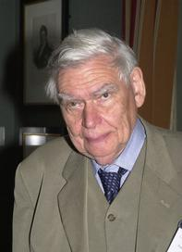
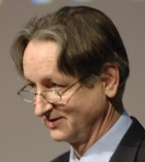
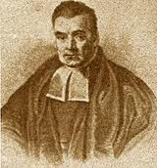

“Objects are always imagined as being present in the field of vision as would have to be there in order to produce the same impression on the nervous mechanism” - von Helmholtz
Hermann von Helmholtz
Richard Gregory
Geoffrey Hinton
The Helmholtz machine and the Bayesian brain
Thomas Bayes
Richard Feynman

Slide 15

“Objects are always imagined as being present in the field of vision as would have to be there in order to produce the same impression on the nervous mechanism” - von Helmholtz
Hermann von Helmholtz
Richard Gregory
Impressions on the Markov blanket…

Slide 16
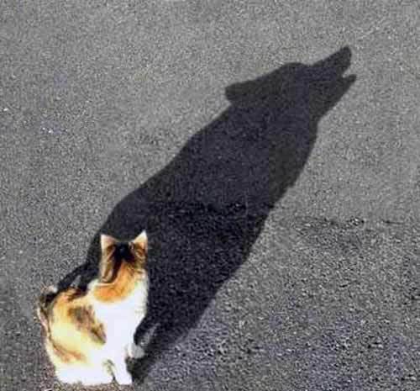
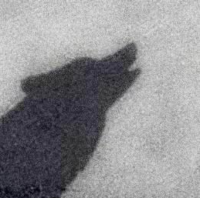
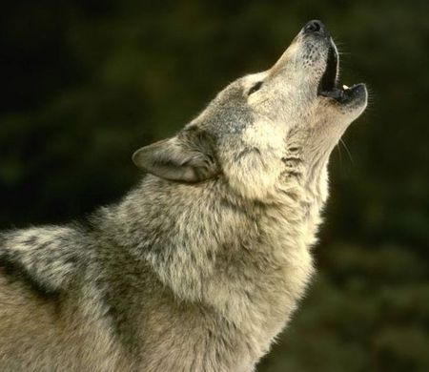
Bayesian filtering and predictive coding
prediction update
prediction error

Slide 17
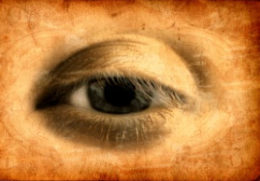
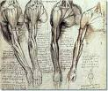
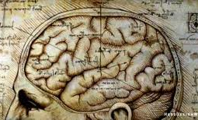
Making our own sensations
sensations – predictions
Prediction error
Action
Perception
Changing sensations
Changing predictions

Slide 18
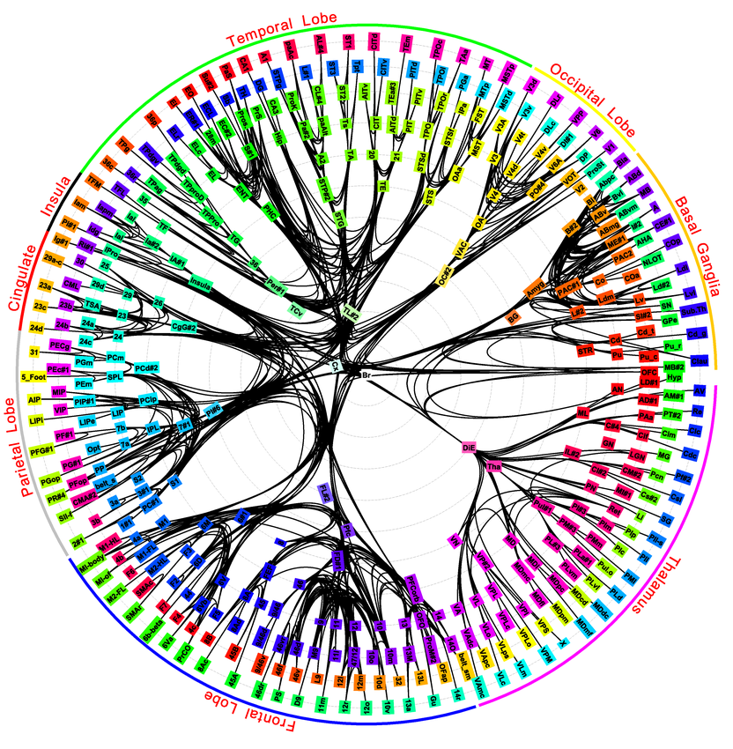
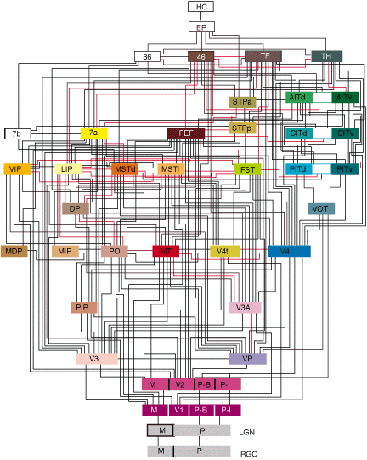
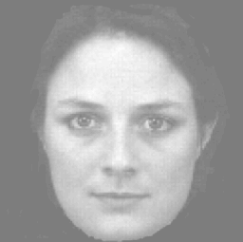
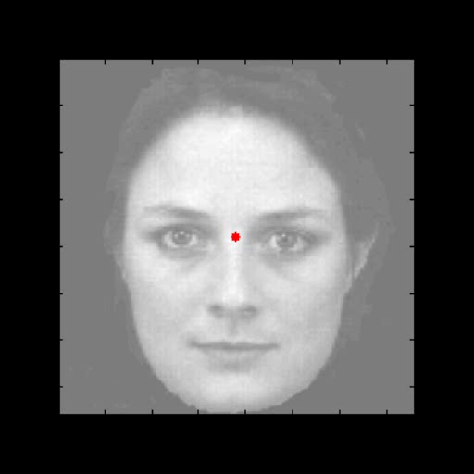

the
Hierarchical generative models
what
where
A simple hierarchy
Descending
predictions
Ascending prediction errors
Sensory fluctuations

Slide 19
Overview
Prediction and life Markov blankets and ergodic systems
Simulations of a primordial soup
The anatomy of inference Graphical models and predictive coding
Canonical microcircuits – in the brain
Action and perception
Knowing your place Multi-agent prediction
Morphogenesis – in other animals

Slide 20
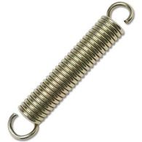
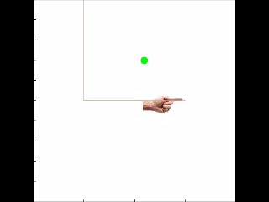
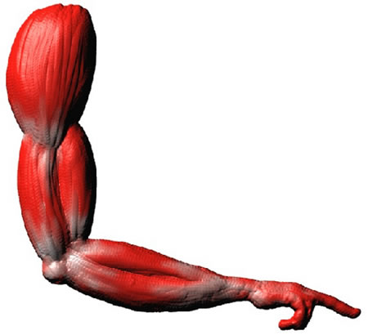
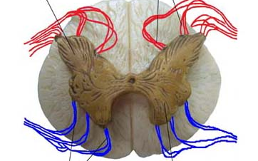
Action with point attractors
visual input
Descending
proprioceptive predictions
proprioceptive input

Slide 21
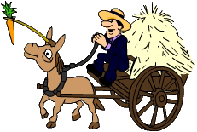


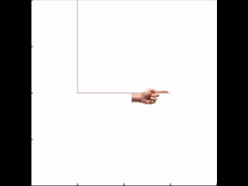
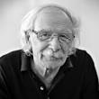
Action with heteroclinic orbits
Descending
proprioceptive predictions
action
observation
0.4
0.6
0.8
position (y)
1
1.2
1.4
0
0.2
0.4
0.6
0.8
1
1.2
1.4
0
0.2
0.4
0.6
0.8
1
1.2
1.4
position (x)
position (x)

Slide 22
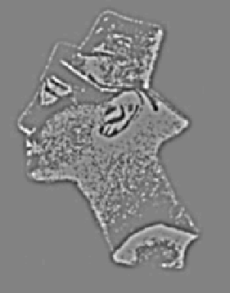
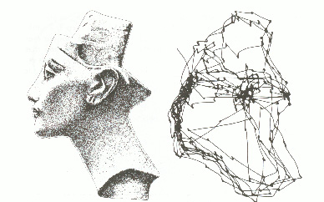
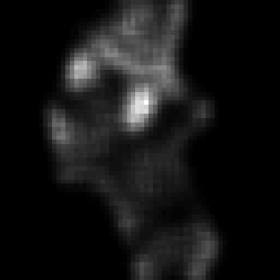
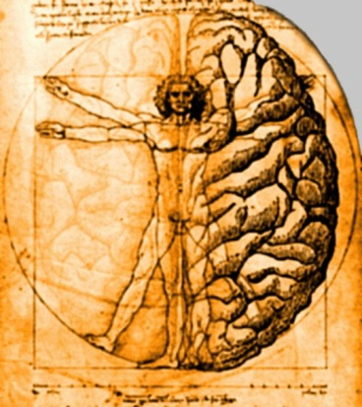

Free energy
Likelihood
Empirical priors
Prior beliefs
Entropy
Energy
“I am [ergodic] therefore I think [I will minimise free energy]”
Epistemic value or information gain
$$\left.σ(u\right)$$
Extrinsic value
stimulus
visual input
salience
sampling
Sampling the world to resolve uncertainty

Slide 23
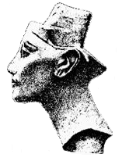
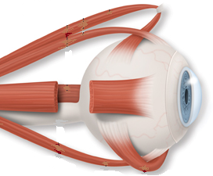
Parietal (where)
Frontal eye fields
Visual cortex
Fusiform (what)
Pulvinar salience map
oculomotor reflex arc
Superior colliculus

Slide 24

Saccadic eye movements
Saccadic fixation and salience maps
Hidden (oculomotor) states
Visual samples
Conditional expectations about hidden (visual) states
vs.
vs.
And corresponding percept

Slide 25
Overview
Prediction and life Markov blankets and ergodic systems
Simulations of a primordial soup
The anatomy of inference Graphical models and predictive coding
Canonical microcircuits
Action and perception
Knowing your place Multi-agent prediction
Morphogenesis

Slide 26
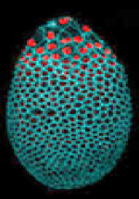
Knowing your place: multi-agent games and morphogenesis
Intercellular signaling
Intrinsic signals
Exogenous signals
Endogenous signals
Generative model

Slide 27
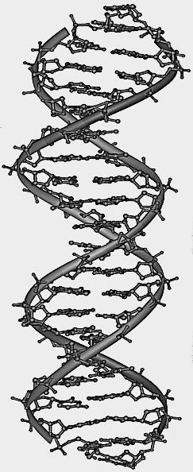
(Genetic) encoding of target morphology
4
Target form
3
2
position
1
0
Position (place code)
-1
-2
-3
-4
-4
-2
0
2
4
Signal expression (genetic code)
4
Extracellular target signal
3
2
1
0
-1
-2
-3
-4
-4
-2
0
2
4
position

Slide 28


Morphogenesis
Expectations
Action
Morphogenesis
3
2.5
4
2.5
2
3
2
1.5
2
1.5
1
1
1
0.5
location
0
0.5
0
-1
0
-0.5
-0.5
-1
-2
-1
-1.5
-3
-1.5
5
10
15
20
25
30
-2
5
10
15
20
25
30
-4
0
5
10
15
20
25
30
35
time
time
time
Free energy
Softmax expectations
Solution
1
4
-340
2
3
3
2
-360
4
1
Free energy
cell
0
-380
5
-1
-400
6
-2
7
-3
-420
8
-4
5
10
15
20
25
30
1
2
3
4
5
6
7
8
-4
-2
0
2
4
time
cell
location

Slide 29
Dysmorphogenesis
Gradient
TARGET
Gradient
Intrinsic
Extrinsic
Extrinsic

Slide 30

Regeneration
Regeneration of head
morphogenesis
4
4
3
3
2
2
1
1
location
0
0
-1
-1
-2
-2
-3
-3
-4
0
5
10
15
20
25
30
35
-4
-4
-2
0
2
4
time
location
morphogenesis
4
3
2
1
location
0
-1
-2
-3
-4
0
5
10
15
20
25
30
35
time
Regeneration of tail

Slide 31
Hermann von Helmholtz
“Each movement we make by which we alter the appearance of objects should be thought of as an experiment designed to test whether we have understood correctly the invariant relations of the phenomena before us, that is, their existence in definite spatial relations.”
‘The Facts of Perception’ (1878) in The Selected Writings of Hermann von Helmholtz, Ed. R. Karl, Middletown: Wesleyan University Press, 1971 p. 384

Slide 32
Thank you
And thanks to collaborators:
Rick Adams
Ryszard Auksztulewicz
Andre Bastos
Sven Bestmann
Harriet Brown
Jean Daunizeau
Mark Edwards
Chris Frith
Thomas FitzGerald
Xiaosi Gu
Stefan Kiebel
James Kilner
Christoph Mathys
Jérémie Mattout
Rosalyn Moran
Dimitri Ognibene
Sasha Ondobaka
Will Penny
Giovanni Pezzulo
Lisa Quattrocki Knight
Francesco Rigoli
Klaas Stephan
Philipp Schwartenbeck
And colleagues:
Micah Allen
Felix Blankenburg
Andy Clark
Peter Dayan
Ray Dolan
Allan Hobson
Paul Fletcher
Pascal Fries
Geoffrey Hinton
James Hopkins
Jakob Hohwy
Mateus Joffily
Henry Kennedy
Simon McGregor
Read Montague
Tobias Nolte
Anil Seth
Mark Solms
Paul Verschure
And many others

Slide 33

A (Markovian) generative model
Likelihood
Control states
Empirical priors – hidden states
– control states
Hidden states
Full priors

Slide 34
Prior beliefs about policies
Quality of a policy = (negative) expected free energy
Extrinsic value
Epistemic value or information gain
Bayesian surprise and Infomax
In the absence of prior beliefs about outcomes:
KL or risk-sensitive control
In the absence of ambiguity:
Expected utility theory
In the absence of uncertainty or risk:
Bayesian surprise
Extrinsic value
Predicted divergence
Predicted mutual information

Slide 35
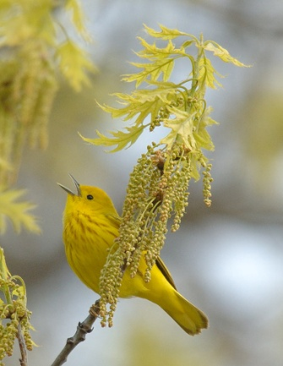
Generative models
Continuous states
Discrete states
Control states
Hidden states
Bayesian filtering
(predictive coding)
Variational Bayes
(belief updating)

Slide 36
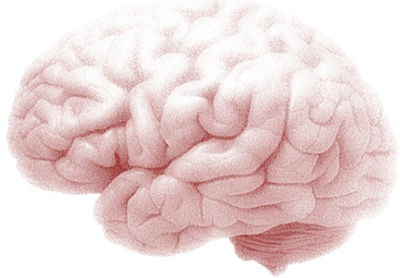
Variational updates
Functional anatomy
Perception
Action selection
Incentive salience
motor Cortex
striatum
occipital Cortex
prefrontal Cortex
Performance
hippocampus
FE
VTA/SN
80
KL
RL
60
DA
success rate (%)
40
20
0
0
0.2
0.4
0.6
0.8
1
Prior preference
Simulated behaviour

Slide 37

Variational updating
Functional anatomy
Perception
Action selection
Incentive salience
motor Cortex
striatum
occipital Cortex
prefrontal Cortex
30
hippocampus
25
20
15
VTA/SN
10
5
0.2
0.4
0.6
0.8
1
1.2
1.4
0.08
0.06
0.04
0.02
0
-0.02
0.25
0.5
0.75
1
1.25
1.5
0.2
0.15
0.1
0.05
0
-0.05
10
20
30
40
50
60
70
80
90
Simulated neuronal behaviour

Slide 38
Continuous or discrete state-space models or both?
Control states
Hidden states

